Slide 1
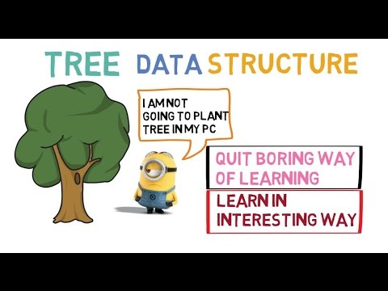
Welcome to CSE 220:
DATA STRUCTURE
Who Am I?
Jannatun Noor
Jannatun.noor@bracu.ac.bd

Slide 2
Necessary Information
From TSR [in BRACU]
From MOODLE [You can access it outside BRACU also]
From my site https://sites.google.com/site/jannatun0abigzero/teaching
Marks will be updated on this site.
Slides are also available there

Slide 3
Tentative Mark Distribution
Section | Marks (%)
Participation in class | 5 %
Quizzes/Class Tests | 8%
Assignments | 12 %
Mid Term Examination | 20 %
Lab including Lab Assignments | 25 %
Final | 30 %
Total | 100 %

Slide 4
Assignments !!! 12 marks
Will be given in my Site
Submit the assignments at due time.
No assignment will be allowed after the deadline. [Strictly]
Never ignore assignments. That will lower your grade.

Slide 5
Books
Algorithms in Java, (3rd Edition), by Robert Sedgewick (main course textbook)
Data Structures by Seymour Lipschutz

Slide 6
Data Structures
In computer science, a data structure is a data organization, management and storage format that enables efficient access and modification. More precisely, a data structure is a collection of data values, the relationships among them, and the functions or operations that can be applied to the data.

Slide 7
Topics to cover
Arrays
Linear Array
Circular Array
2D Array
Linked Lists
Singly Linked List
Doubly Linked List
Stacks
Queue
Trees
Graphs
Others

Slide 8
Applications
Arrays
Linear Array
Circular Array
2D Array
Linked Lists
Singly Linked List
Doubly Linked List
Stacks
Queue
Trees
Graphs

Slide 9
Class & Object
An object represents an entity in the real world that can be distinctly identified.
For example, a student, a desk, a circle, a button, and even a loan can all be viewed as objects. An object has a unique identity, state, and behavior.
■ The state of an object (also known as its properties or attributes) is represented by data fields with their current values. A circle object, for example, has a data field radius, which is the property that characterizes a circle. A rectangle object has data fields width and height, which are the properties that characterize a rectangle.
■ The behavior of an object (also known as its actions) is defined by methods. To invoke a method on an object is to ask the object to perform an action. For example, you may define a method named getArea() for circle objects. A circle object may invoke getArea() to return its area.

Slide 10
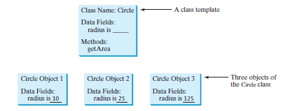

Slide 11
Java data types
Java primitives
char
String
Boolean
Numeric
Non-numeric
Byte
Int
…

Slide 12
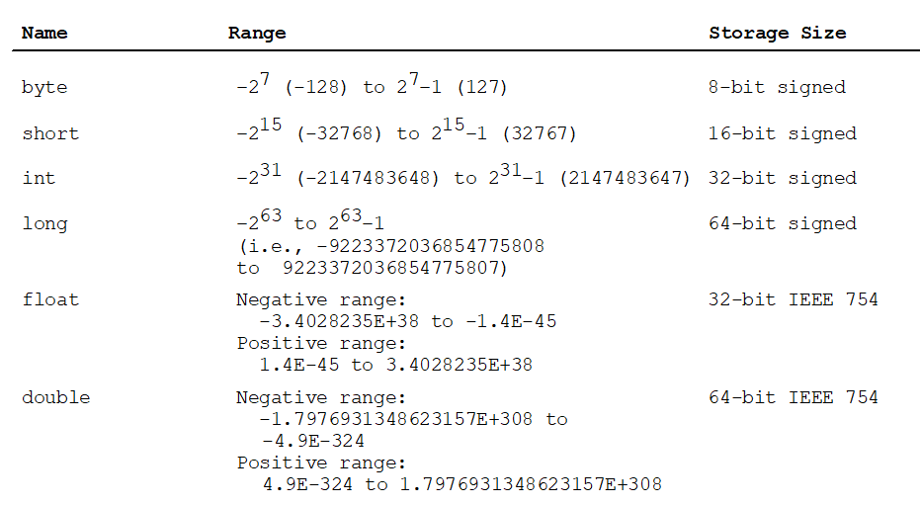
Java Numerical Primitives

Slide 13
Variables
public class Example1
{
public static void main ( String[] args )
{
int payAmount = 123;
System.out.println("The variable contains: " + payAmount );
}
}

Slide 14
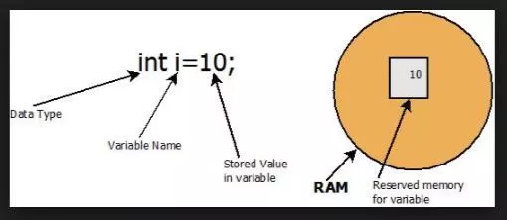
Variables in Java Memory

Slide 15
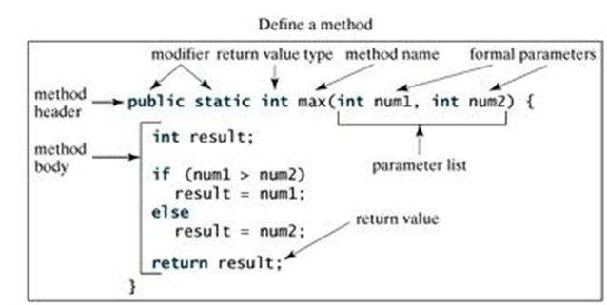
Methods

Slide 16
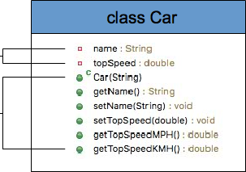
Class
variables
methods

Slide 17
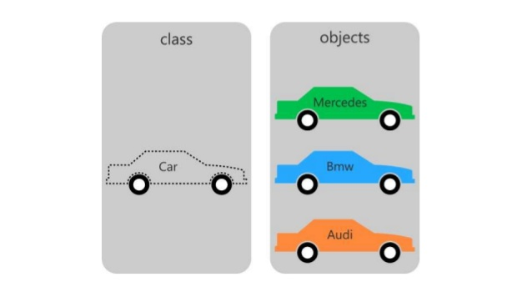
Objects

Slide 18
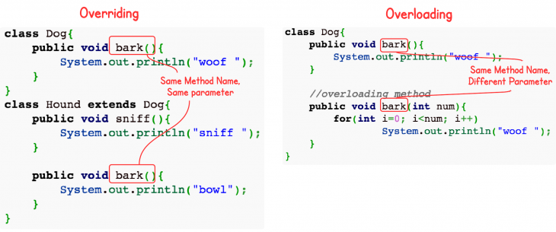
Overloading and Overriding

